Slide 1
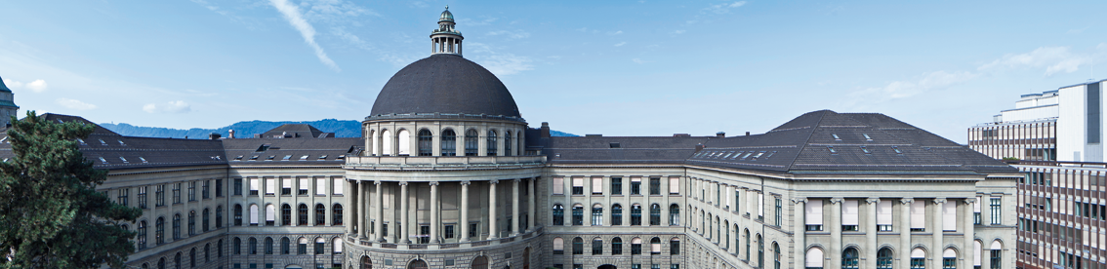
Proposal Presentation
Deep Relative Pose Estimation for Stereo Camera

Slide 2
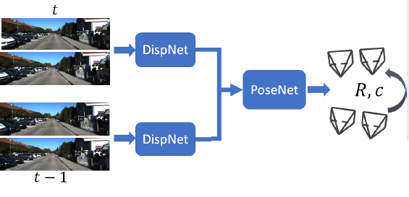

Goal
Designing an end-to-end neural network for depth and relative pose estimation between two frames of a stereo camera

Slide 3
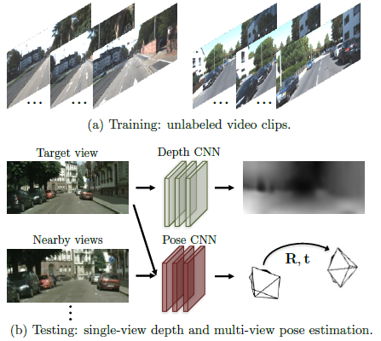
Existing work
Depth and relative pose estimation for a monocular camera
Tinghui Zhou, Matthew Brown, Noah Snavely, and David G. Lowe. Unsupervised learning of depth and ego-motion from video.

Slide 4
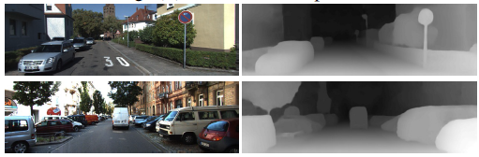
Existing work
DispNet, an algorith estimating depth from images of a stereo camera
N.Mayer, E.Ilg, P.Häusser, P.Fischer, D.Cremers, A.Dosovitskiy, and T.Brox. A large dataset to train convolutional networks for disparity,
optical flow, and scene flow estimation.

Slide 5
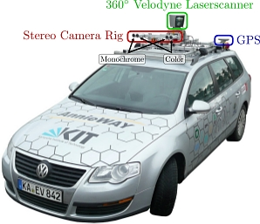

Approach
Get familiar with existing work
Experiment with DispNet method
Implement deep stereo method as first part of pipeline
Unsupervised training of network with KITTI dataset
Validation of results
If time allows, implement an explanatory mask

Slide 6
Implementation
Python
Linux
DispNet
For disparity estimation
Tensorflow,
a widely used open-source machine learning framework

Slide 7
